Slide 1

Becoming Azure KQL Ninja!
Prateek Singh

Slide 2





>_ Whoami
/in/prateekkumarsingh
@singhprateik
/prateekkumarsingh
leanpub.com/b/books

Slide 3
>_ Agenda
What is KQL? Why does it matter & its history
Azure Monitor and Common Data Platform
Demo 1 – KQL Primer to Advance* techniques
Demo 2 - Using KQL to query data in a Web Application
Thank you and Questions

Slide 4
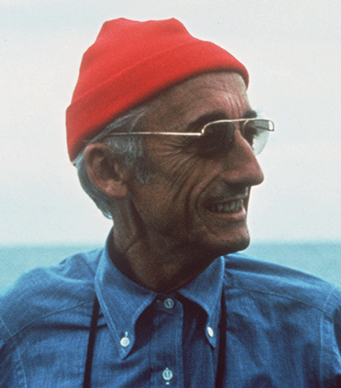
>_ What is Azure KQL?
Kusto Query Language (KQL) is a powerful tool for
Data exploration (Big data analytics)
Pattern discovery
Anomaly detection
Statistical modeling
Fast, Pipeline-driven and Read-only query language
Why should you learn KQL?
Works well with MSFT ecosystem
Azure Data Explorer (Health care, Finance etc.)
Azure Monitor (Observability using Azure Log Analytics, Application Insights)
Azure Sentinel / Microsoft Defender for Cloud (Cyber Security)
Azure Resource Graph*
Versatile
Wide variety of supported data sources and types
Wide range of operators/functions for complex data analysis and transformation.
Profession / Skill
Cloud Architects / System Engineer
Cyber Security Specialist
Data Engineers
Software Engineers
'Kusto’ is named after Jacques Cousteau, as a reference to "exploring the ocean of data” Kusto was Internal project code name @MSFT

Slide 5

Purpose of Layout: Do this first, before you doanything. It’s vital to have the correct fonts installed before youstart.
>_ History of KQL
2021
Azure Data Explorer's next generation storage and query engine, "Kusto EngineV3", becomes GA
2019
Kusto becomes the backend big-data & analytics service for Application Insights Analytics
GA announcement @ MSFT Ignite conference
2016
2018
Public Preview announcement @ Microsoft Ignite
2014
Development of Kusto project begins in the MSFT Israeli R&D center

Slide 6
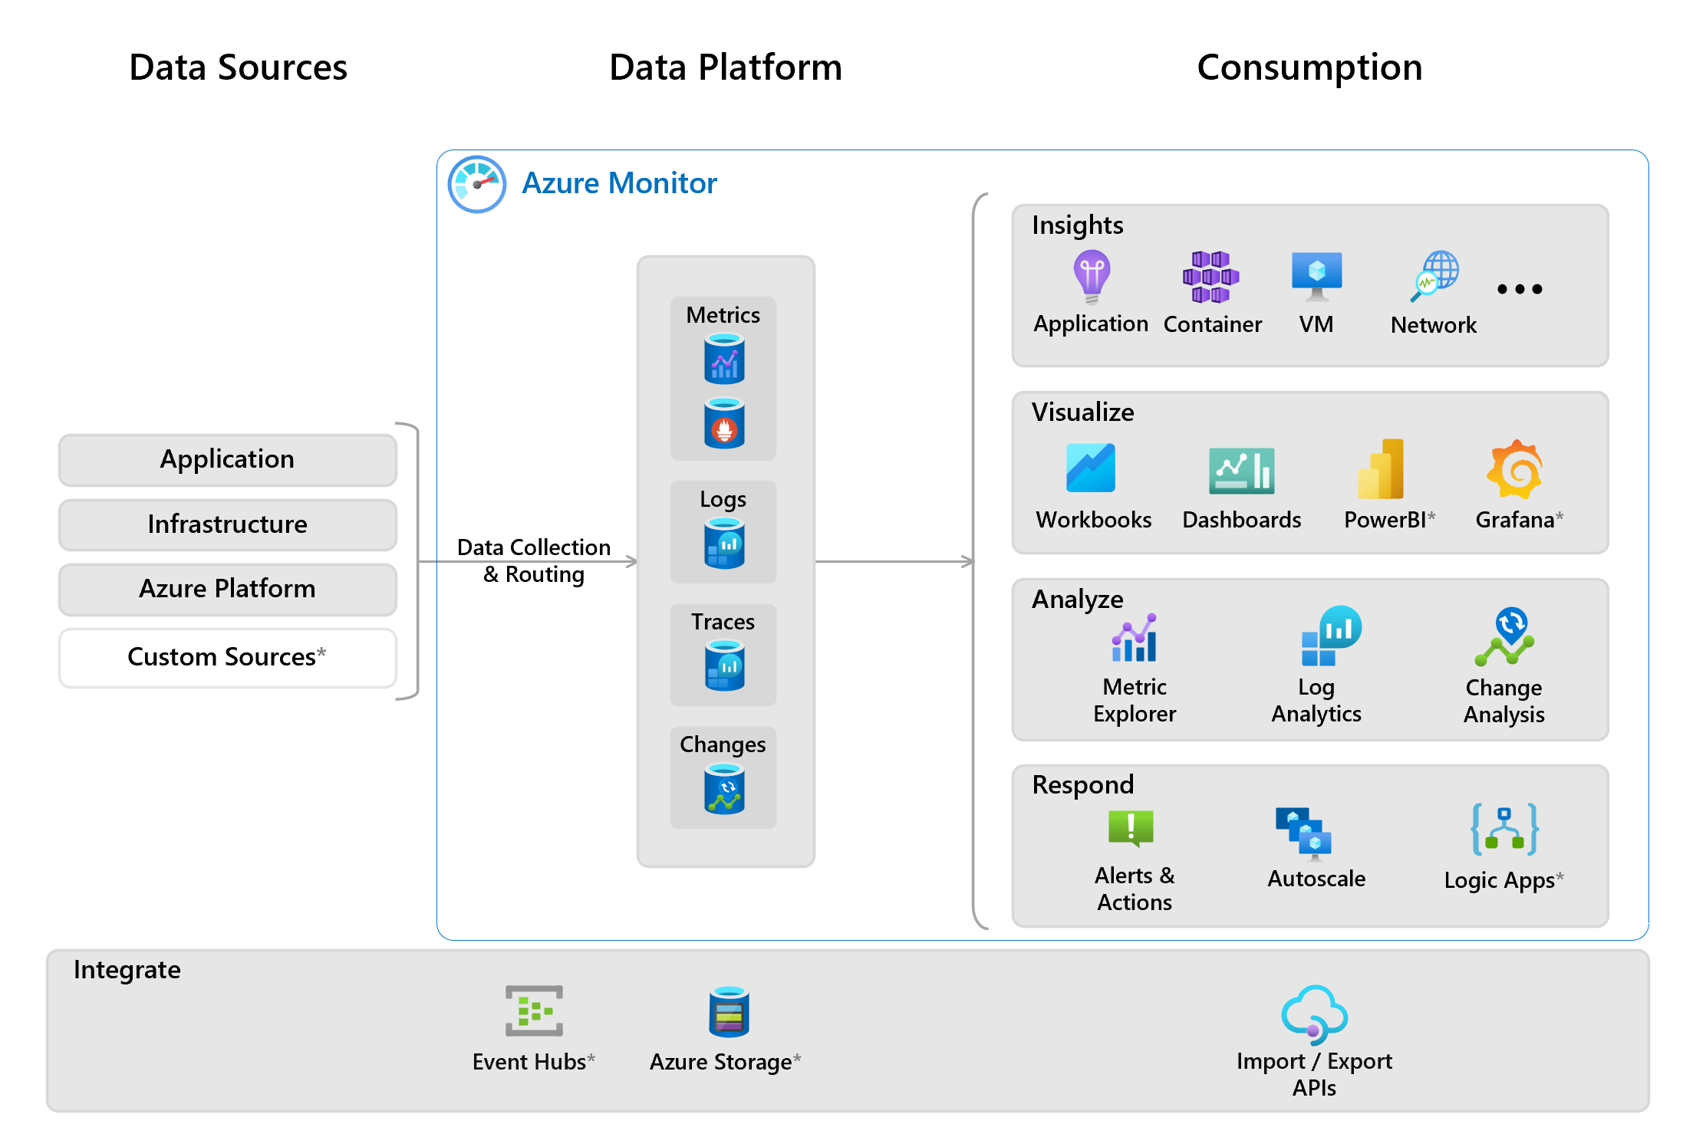
But where is my data?

Slide 7
DEMO - 1
KQL Primer to Advance* techniques

Slide 8
DEMO - 2
Using KQL and Log Analytics in a Web Application

Slide 9
Thank you!
Get the slide deck and code samples on: https://github.com/prateekkumarsingh/presentations

